Slide 1

*Unbundled* code splitting strategy @Seia-Soto (Ho-Jeong Go)

Slide 2
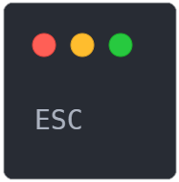
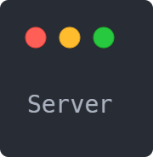
Bundling with Webpack
Being old but still the strategy.
HTTP/1.1 is not made for sending multiple files at the time.
Webpack is a solution for tying various dependencies and code, which called ‘bundling’.
The minified and small code bundle. The server will serve this bundle instead.
Code
Bundle
Styles
Dependencies
Figure 1. Webpack with Client

Slide 3

Code splitting on Webpack
The basic code-splitting technology.
By lazy loading components on FE part, you can split the codes with *chunks*.
The purpose of code-splitting is avoiding sending all codes which includes useless ones to end-user.
Every request creates new full HTTP request with server
Static assets
Chunks
Web browser (Chromium*)
Chunks
Chunks
Website entry
Chunks are created on build time of webpack which mainly because of code-splitting
Webpack runtime
Figure 2. Webpack code-splitting

Slide 4
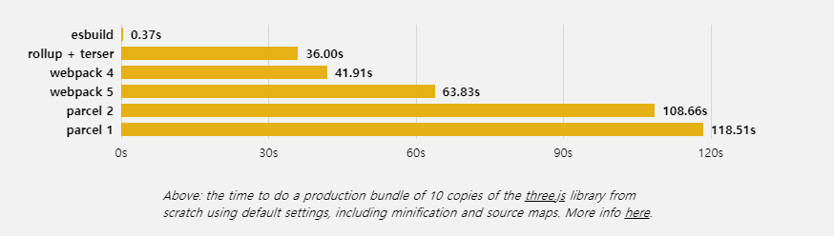
Huge changes on current web environment
A lot of new technology for developing web applications are created.
HTTP/2 can ship many materials such as your code with single *connection*.
ESBuild is faster than any existing bundlers such as webpack or rollup.
All assets can be transferred in single connection
FTL!
Web browser (Chromium*)
Figure 3. New technologies

Slide 5
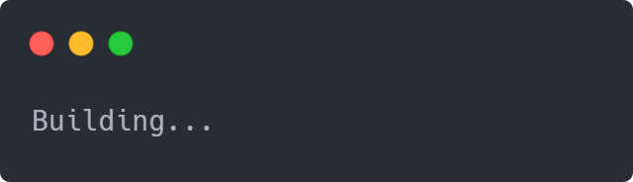
See experience with bundlers
It’s not only you want, avoid using it all even in useless condition.
Bundlers contains its runtime, also has the impact on your website.
The build time is really *longer* than ESBuild which I introduced in prior page.
Webpack says that it bundles all your assets but it isn’t good always.
<Recipe of Chunk>
Your code
*Dependencies*
This is very well-known console output for React developers with webpack dev server.
Long time to see the result because of bundler.
Static assets
Chunks
Chunks
Chunks
If cache invalidation performed, users need to download all *dependencies* again, not only your code. This means that user can also download useless parts.
Website entry
Webpack runtime
Figure 4. Problems with bundler

Slide 6
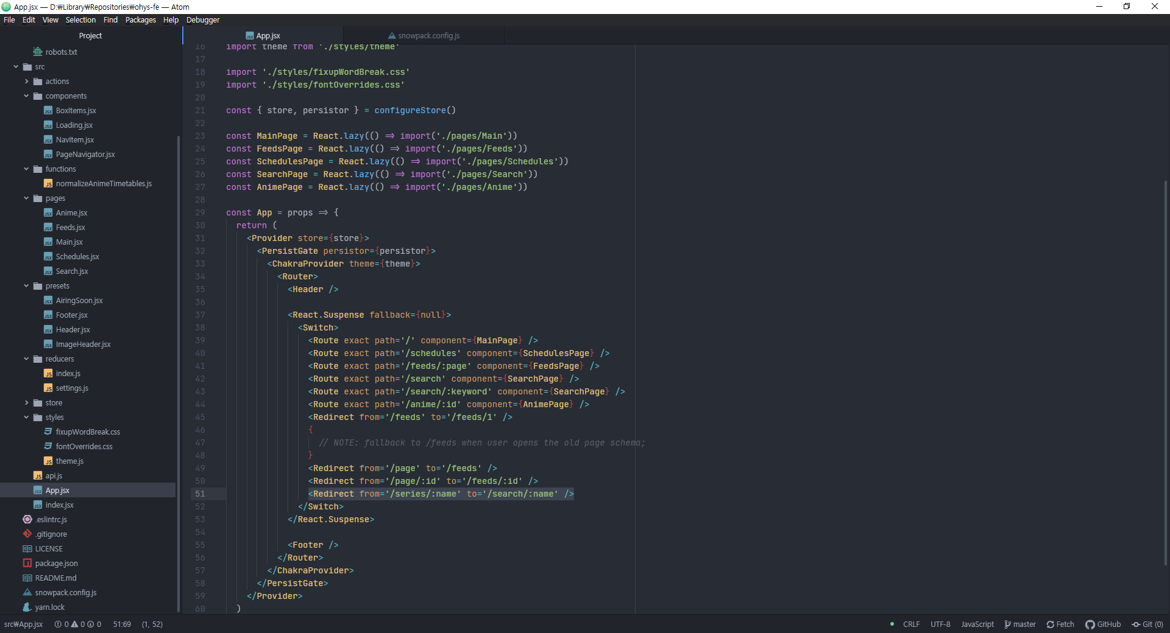
Testing with actual project
Ohys-FE.
We’re going to see what’s happening after removing one line.
Snowpack will build the source-code.
First with webpack and second case is unbundled. Then, we’ll open the server with ‘serve –s build’ command.
Figure 5. Creating test

Slide 7
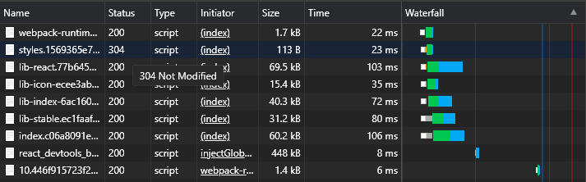
Useless requests are made
Lazy loading components are not enough with bundlers.
Web browser doesn’t know the exact location of dependencies and all things are re-cached after changing one line. (over 200 kB)
200: Get all you need
I want some JS
Web browser (Chromium*)
Figure 6. Browser doesn’t know webpack

Slide 8
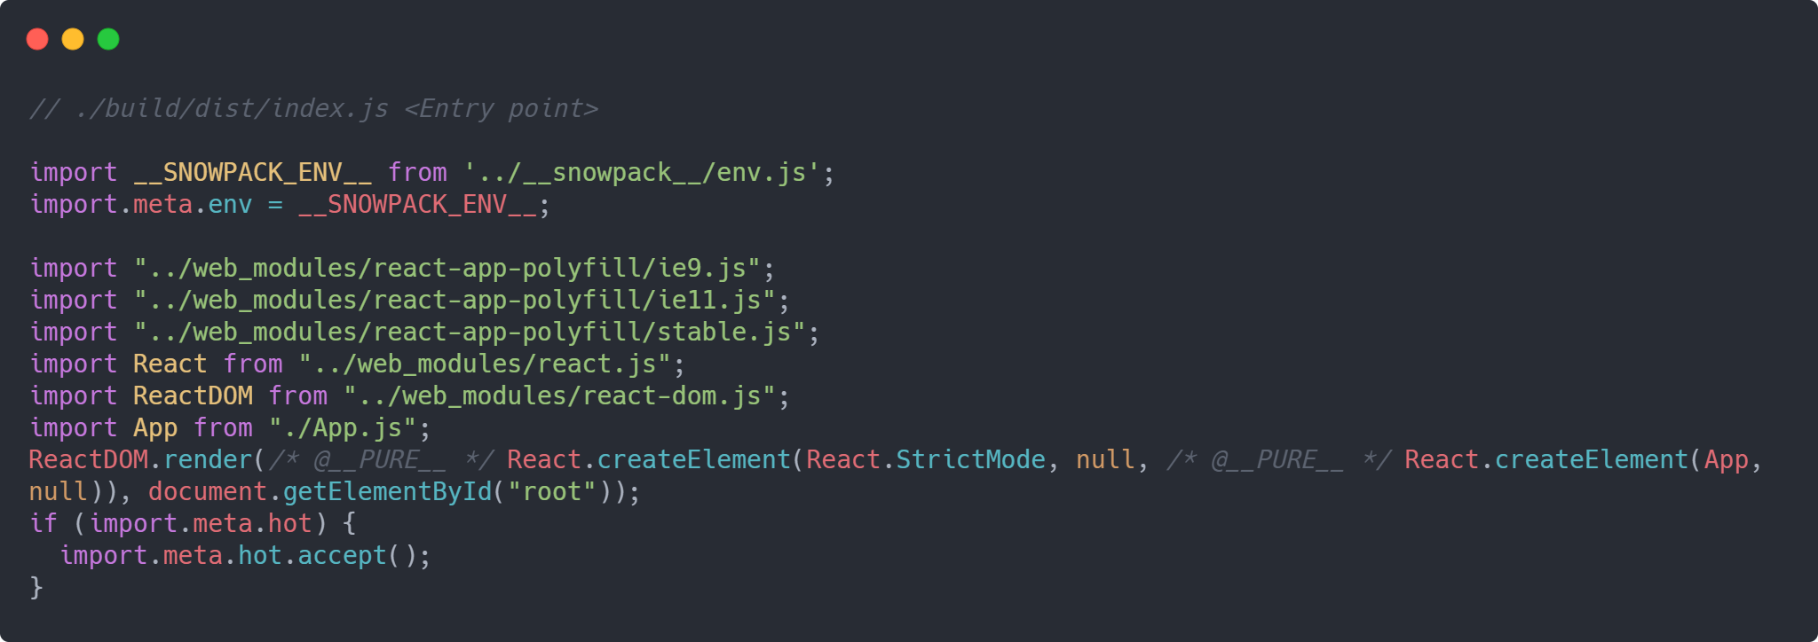
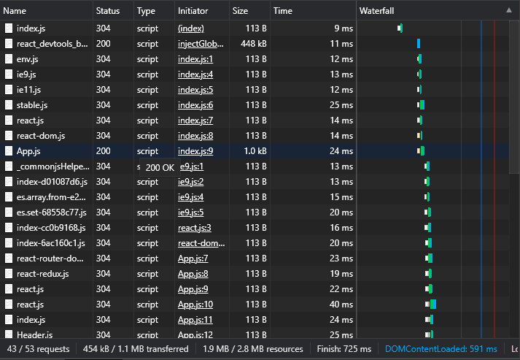
Code-splitting becomes easy without bundlers
Lazy loading component is enough. No more.
Web browser knows the exact location of each JS and because of ESM, all modules won’t loaded and instantized at initiating time.
(Actual build result of Snowpack app: Ohys-FE)
Dependencies are not modified (HTTP 304)
Only modified file requested (1.0 kB / HTTP 200)
304: File is not modified
I want some JS
Web browser (Chromium*)
Figure 7. Web browser know this application

Slide 9
Traffic controlling via CDN on micro-frontends
All core assets are shared via CDN, this make apps centralized but divided at the time.
Thanks to zhoukekestar, similar ideas are already formed nicely.
Optimization of traffic will be reached by CDN providers.
Each micro-services (or micro-frontends) are not required to worry about duplicated assets.
Microservice
ESM CDN Providers
e.g. Skypack
Shared CDN requests
Microservice
Only application code will be transferred
Web browser (Chromium*)
Figure 8. Micro-Frontend situation

Slide 10
Future workarounds to ‘MOVE THE WEB FORWARD’
Web ecosystems are all progressive but need to think backward compatibility.
Implementation of HTTP/2 and this requires HTTPS by default.
Still mobile network is not that reliable.
Client may disable JavaScript and still there are Internet Explorer users.

Slide 11
Thank you
Font: Inter.
GitHub: @Seia-Soto
Twitter: @Seia-Soto, @fluentAroma

